Slide 1
Group 18 NETWORK OF CYCLES
CS321: Computer Peripherals and Interfacing Lab
Course Instructor : Prof. S. B. Nair

Slide 2
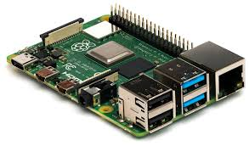
Features Implemented
Automatic issue and return policy
Tracking of cycle
Fencing proximity
Anti theft system
Alarm for notifications
User friendly app

Slide 3
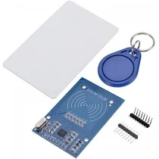
Automatic issue & return
Using RFID reader installed in the cycle we can read the tags provided to the user using this user can issue and return the cycle

Slide 4
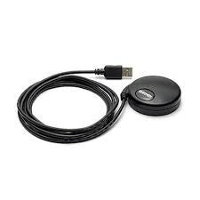
Tracking and Fencing Proximity
With the help of GPS device we are tracking the cycle
Raising an alarm to notify user if user crosses stipulated area i.e. fencing proximity – This we did by restricting the longitude and latitude values in a given range.

Slide 5
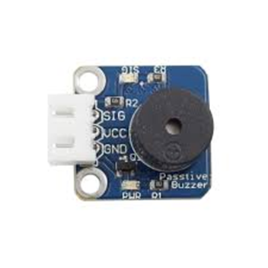
Anti Theft System
We used a buzzer alarm which rings when an unauthourized user tries to issue the cycle.
There is a motion sensor also installed in the cycle which will be active only when the cycle is not issued by any user
This prevents cycle from is being stolen

Slide 6
User Friendly App
Displays history of cycle issue-return
Current user of the cycle
Location of the cycle

